Slide 1
Chapter 8:
Searching and Sorting Arrays

Slide 2
8.1
Introduction to Search Algorithms

Slide 3
Introduction to Search Algorithms
Search: locate an item in a list of information
Two algorithms we will examine:
  Linear search
  Binary search

Slide 4
Introduction to Search Algorithms
Two algorithms we will examine:
  Linear search
  Binary search

Slide 5
1. Linear Search
Also called the sequential search
Starting at the first element, this algorithm sequentially steps through an array examining each element until it locates the value it is searching for.

Slide 6
1. Linear Search - Example
Array numlist contains:
Searching for the the value 11, linear search examines 17, 23, 5, and 11
Searching for the the value 7, linear search examines 17, 23, 5, 11, 2, 29, and 3
17 | 23 | 5 | 11 | 2 | 29 | 3

Slide 7
Algorithm
set found to false; set position to –1; set index to 0
while index < number of elts. and found is false
if list[index] is equal to search value
found = true
position = index
end if
add 1 to index
end while
return position

Slide 8
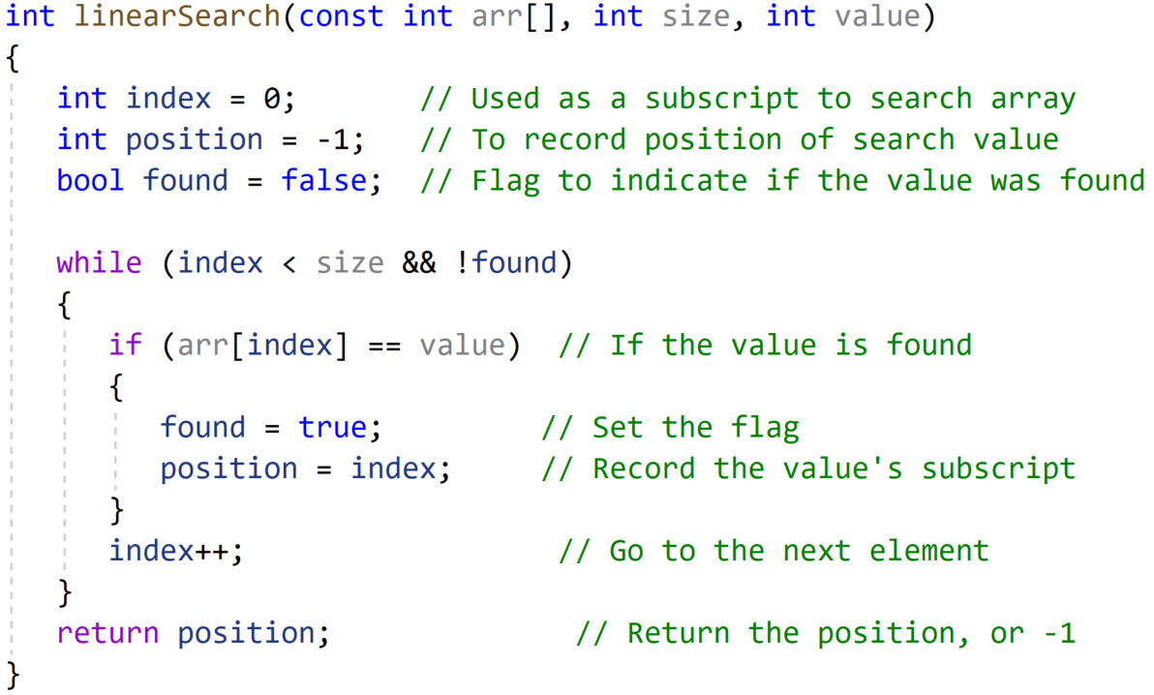
17 | 23 | 5 | 11 | 2 | 29 | 3

Slide 9
Linear Search - Tradeoffs
Benefits:
  Easy algorithm to understand
  Array can be in any order
Disadvantages:
  Inefficient (slow): for array of N elements, examines N/2 elements on average for value in array, N elements for value not in array

Slide 10
Introduction to Search Algorithms
Two algorithms we will examine:
  Linear search
  Binary search

Slide 11
2. Binary Search
Requires array elements to be in order
  Divides the array into three sections:
    middle element
    elements on one side of the middle element
    elements on the other side of the middle element
  If the middle element is the correct value, done. Otherwise, go to step 1. using only the half of the array that may contain the correct value.
  Continue steps 1. and 2. until either the value is found or there are no more elements to examine

Slide 12
2. Binary Search - Example
Array numlist2 contains:
Searching for the the value 11, binary search examines 11 and stops
Searching for the the value 7, linear search examines 11, 3, 5, and stops
2 | 3 | 5 | 11 | 17 | 23 | 29

Slide 13
Algorithm
Set first to 0
Set last to the last subscript in the array
Set found to false
Set position to -1
While found is not true and first is less than or equal to last
Set middle to the subscript half-way between array[first] and array[last].
If array[middle] equals the desired value
Set found to true
Set position to middle
Else If array[middle] is greater than the desired value
Set last to middle - 1
Else
Set first to middle + 1
End If.
End While.
Return position.

Slide 14
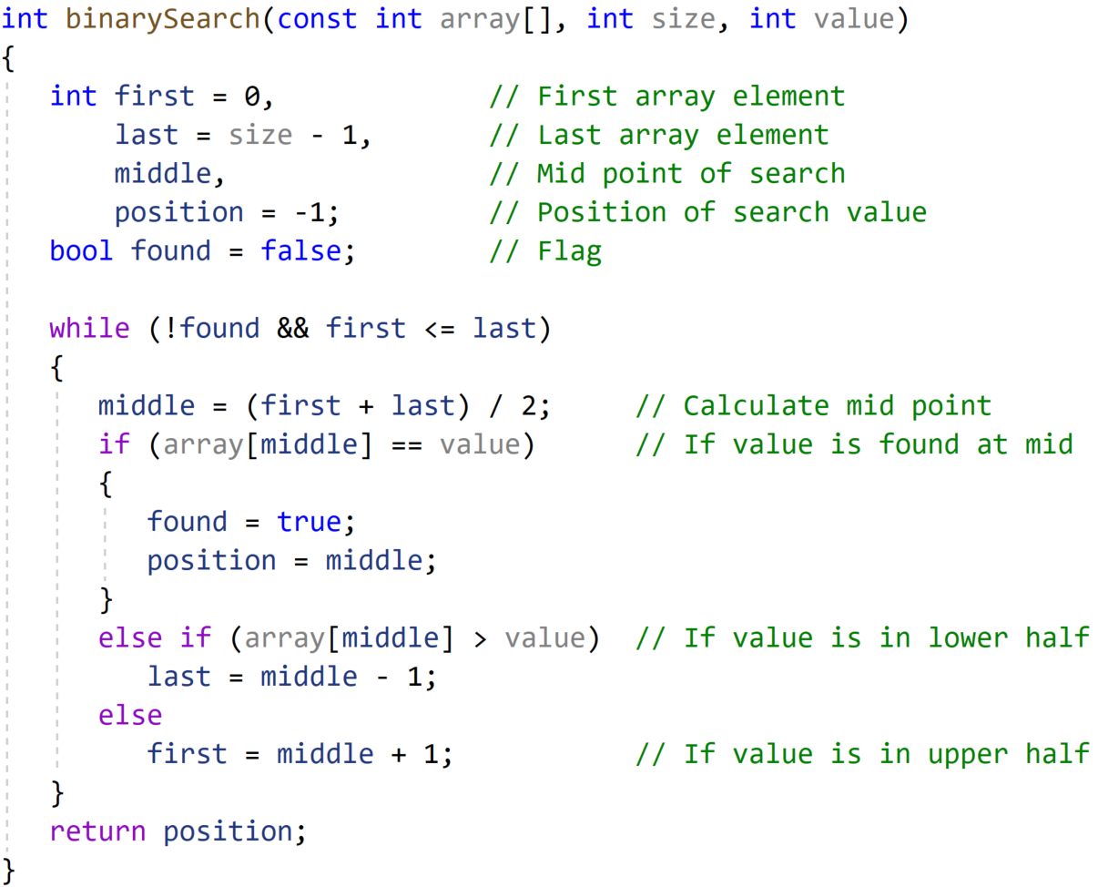
2 | 3 | 5 | 11 | 17 | 23 | 29

Slide 15
Binary Search - Tradeoffs
Benefits:
  Much more efficient than linear search. For array of N elements, performs at most log₂N comparisons
Disadvantages:
  Requires that array elements be sorted

Slide 16
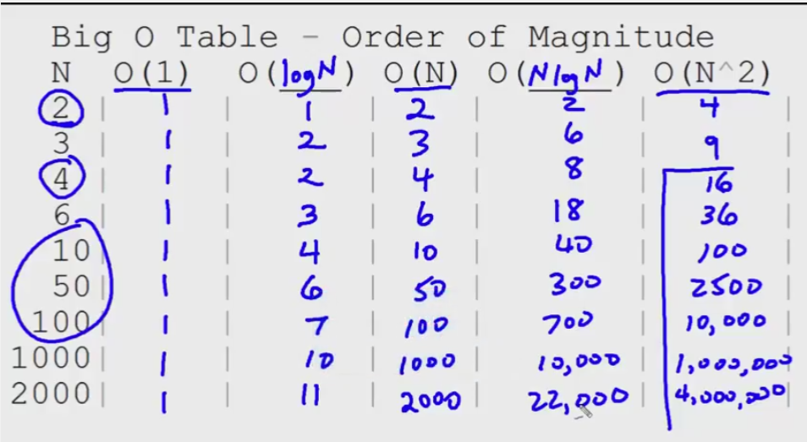

Slide 17
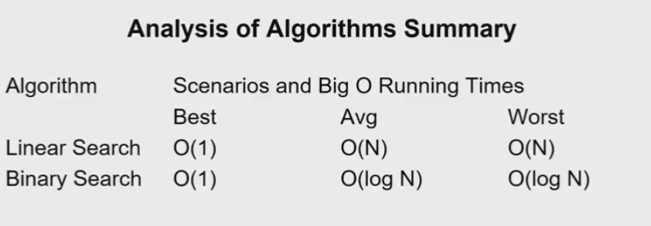
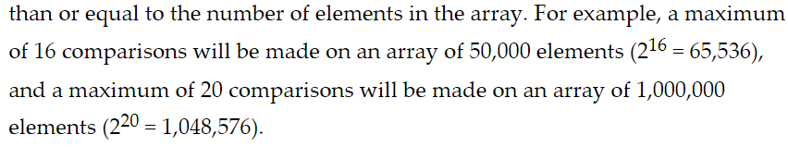
O(N/2)

Slide 18
8.3
Introduction to Sorting Algorithms

Slide 19
Introduction to Sorting Algorithms
Sort: arrange values into an order:
  Alphabetical
  Ascending numeric
  Descending numeric
Two algorithms considered here:
  Bubble sort (Bottom Up)
  Selection sort (Top Down)

Slide 20
Introduction to Sorting Algorithms
Two algorithms considered here:
  Bubble sort
  Selection sort

Slide 21

1. Bubble Sort
Concept:
  Compare 1st two elements
    If out of order, exchange them to put in order
  Move down one element, compare 2nd and 3rd elements, exchange if necessary. Continue until end of array.
  Pass through array again, exchanging as necessary
  Repeat until pass made with no exchanges

Slide 22
Example – First Pass
Array numlist3 contains:
17 | 23 | 5 | 11
compare values
17 and 23 – in correct
order, so no exchange
compare values 23 and
11 – not in correct order,
so exchange them
compare values 23 and
5 – not in correct order,
so exchange them

Slide 23
Example – Second Pass
After first pass, array numlist3 contains:
17 | 5 | 11 | 23
compare values 17 and
5 – not in correct order,
so exchange them
compare values 17 and
23 – in correct order,
so no exchange
compare values 17 and
11 – not in correct order,
so exchange them

Slide 24
Example – Third Pass
After second pass, array numlist3 contains:
5 | 11 | 17 | 23
compare values 5 and
11 – in correct order,
so no exchange
compare values 17 and
23 – in correct order,
so no exchange
compare values 11 and
17 – in correct order,
so no exchange
No exchanges, so
array is in order

Slide 25
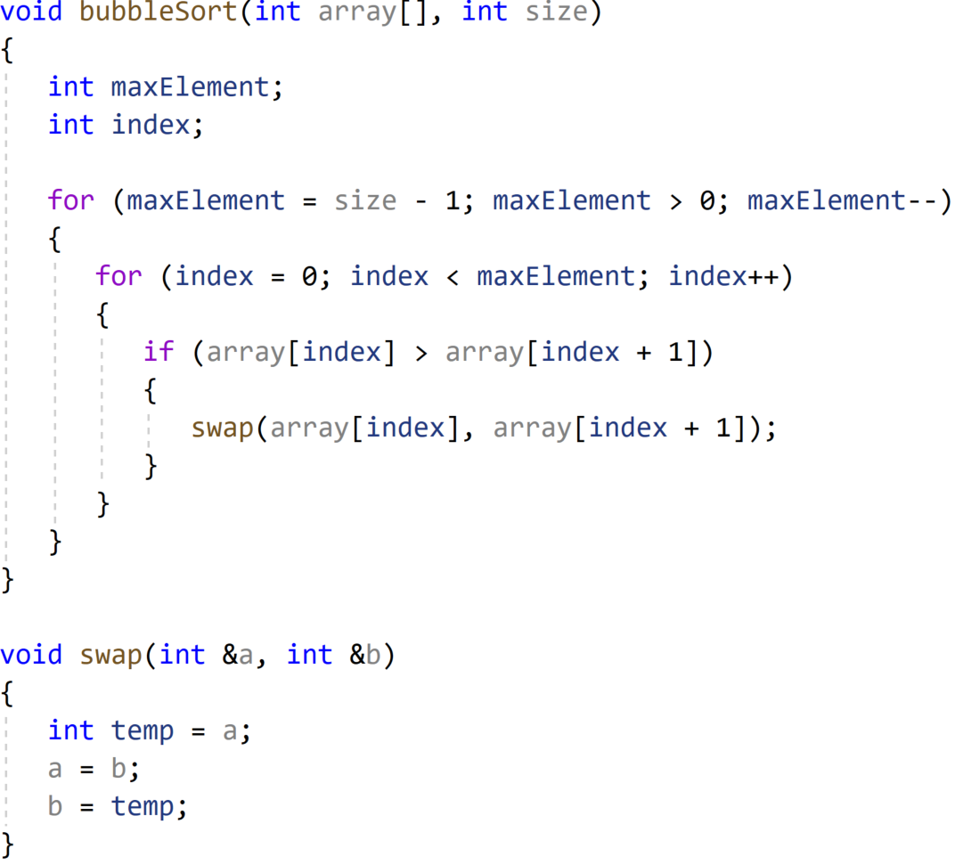
17 | 23 | 5 | 11

Slide 26
Bubble Sort - Tradeoffs
Benefit:
  Easy to understand and implement
Disadvantage:
  Inefficient: slow for large arrays

Slide 27
Introduction to Sorting Algorithms
Two algorithms considered here:
  Bubble sort
  Selection sort

Slide 28
2. Selection Sort
Concept for sort in ascending order:
  Locate smallest element in array. Exchange it with element in position 0
  Locate next smallest element in array. Exchange it with element in position 1.
  Continue until all elements are arranged in order

Slide 29
2. Selection Sort - Example
Array numlist contains:
Smallest element is 2. Exchange 2 with element in 1st position in array:
11 | 2 | 29 | 3
2 | 11 | 29 | 3

Slide 30
Example (Continued)
Next smallest element is 3. Exchange 3 with element in 2nd position in array:
Next smallest element is 11. Exchange 11 with element in 3rd position in array:
2 | 3 | 29 | 11
2 | 3 | 11 | 29

Slide 31
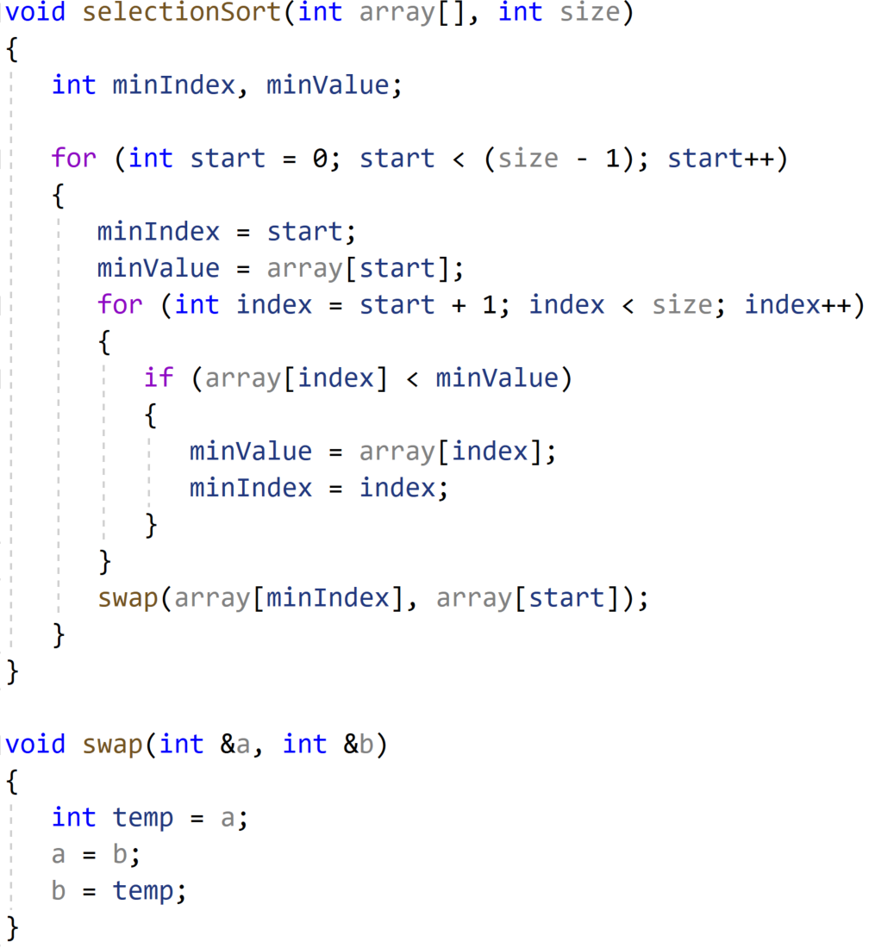
11 | 2 | 29 | 3
Find Lowest Value

Slide 32
Selection Sort - Tradeoffs
Benefit:
  More efficient than Bubble Sort, since fewer exchanges
Disadvantage:
  May not be as easy as Bubble Sort to understand

Slide 33
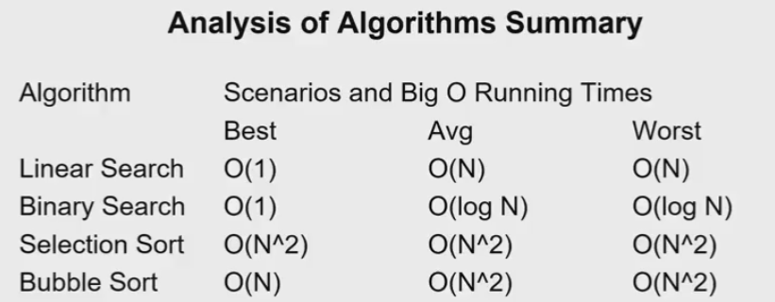
Two for loops + swapping operation → O(N^2)

Slide 34
8.5
Sorting and Searching Vectors

Slide 35
Sorting and Searching Vectors
Sorting and searching algorithms can be applied to vectors as well as arrays
Need slight modifications to functions to use vector arguments:
  vector <type> & used in prototype
  No need to indicate vector size – functions can use size member function to calculate
Refer to Pr8.7

